Slide 1
Final Project: Prediction of PPG Product Sales
Hua Ji
Spring, 2022

Slide 2
Project Objectives:
The company (PPG) wants the Sales Reps to spend the most time on the products that generate the most revenue. Two things need to be determined:
Predict the average hours per week Sales Reps spend on a product,
Classify if the product achieves the specified sales target.
Ultimately, the company wants to know which customers are the most difficult to predict in terms of time and achieving sales goals.

Slide 3
In order to reach the objectives, the following features will serve as inputs to machine learning models:
Categorical input variables
1a. Region with three levels (XX, YY, and ZZ)
1b. Customers with nine levels (A, B, D, E, G, K, M, Q and others)
Continuous input variables - sentiment derived features
2a. Bing lexicon derived features - xb
2b. NRC lexicon derived features - xn
2c. AFINN lexicon derived features – xa
2d. Word count derived features – xw
2e. Sentimentr derived features - xs

Slide 4
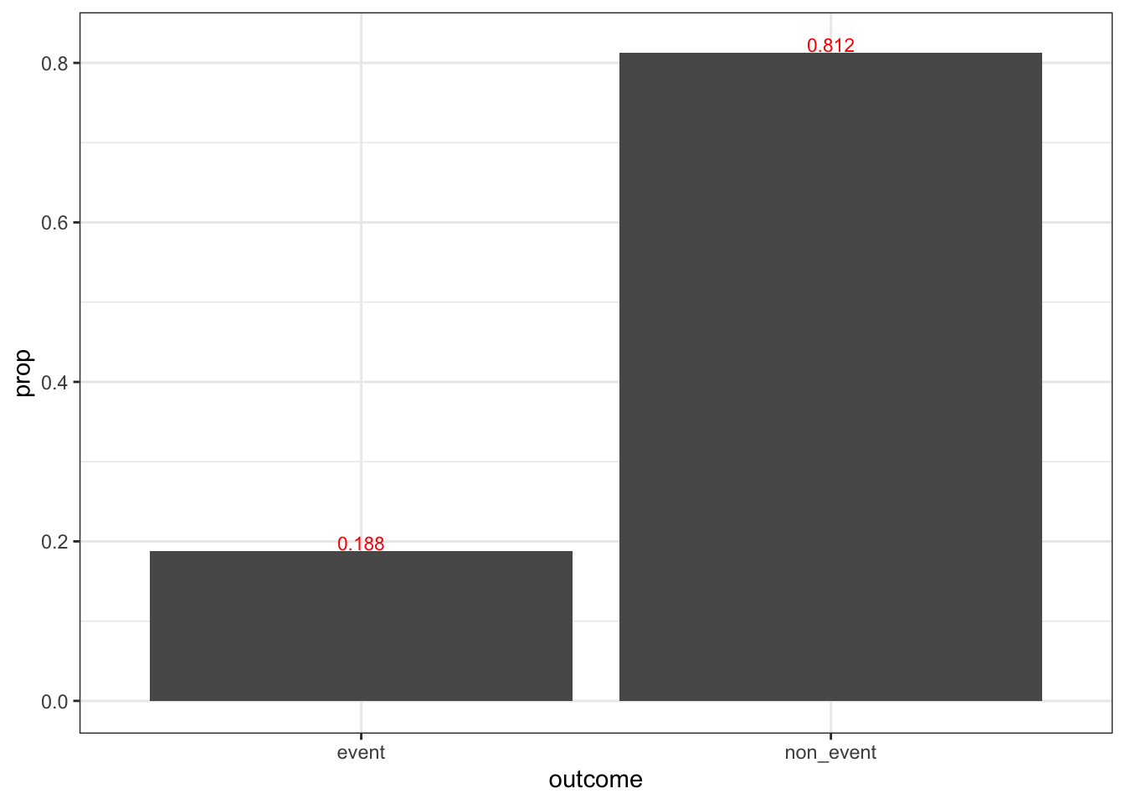
Part I: Data Exploration
Categorical output variable

Slide 5
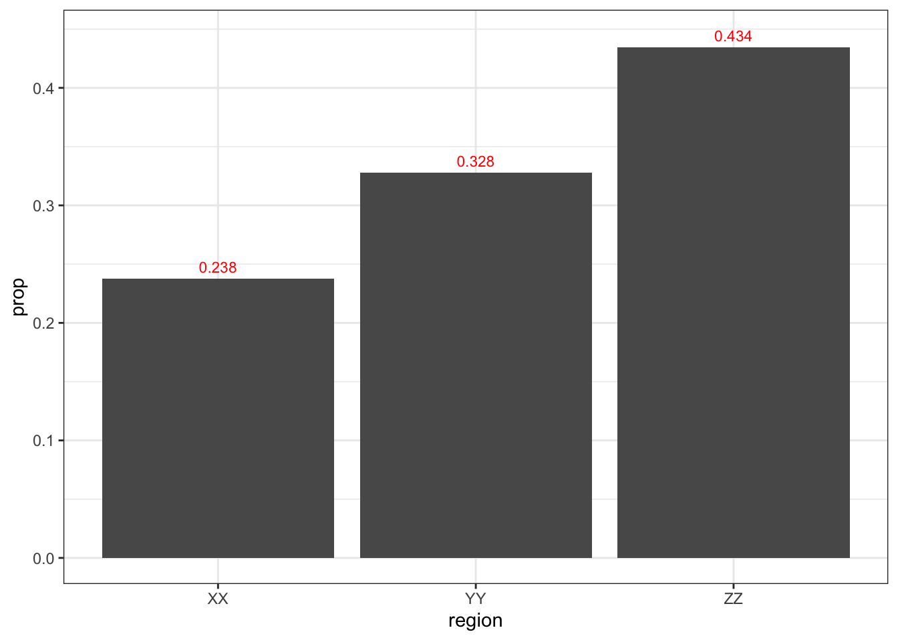
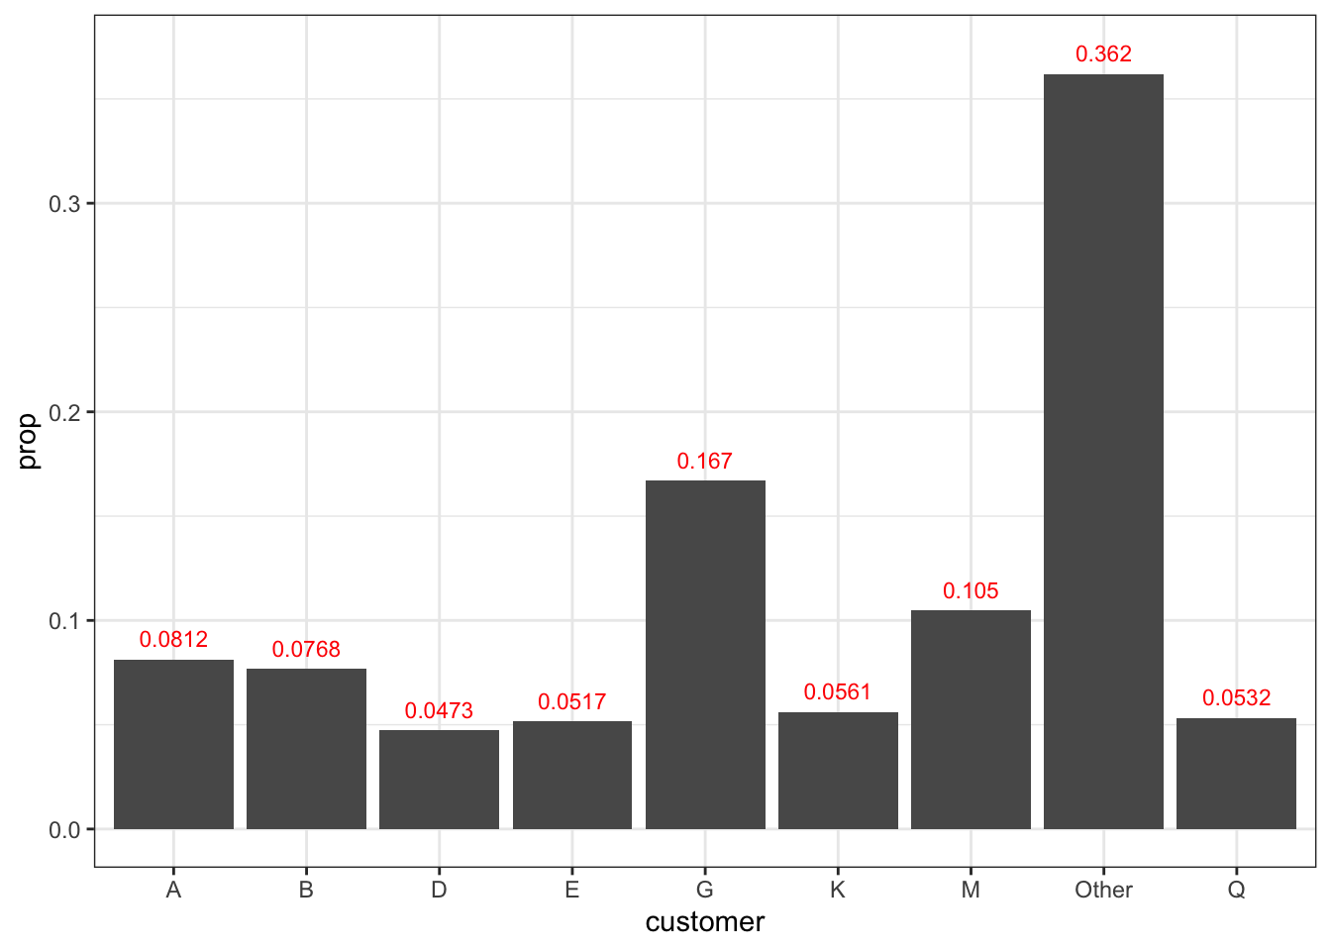
Categorical input variables

Slide 6
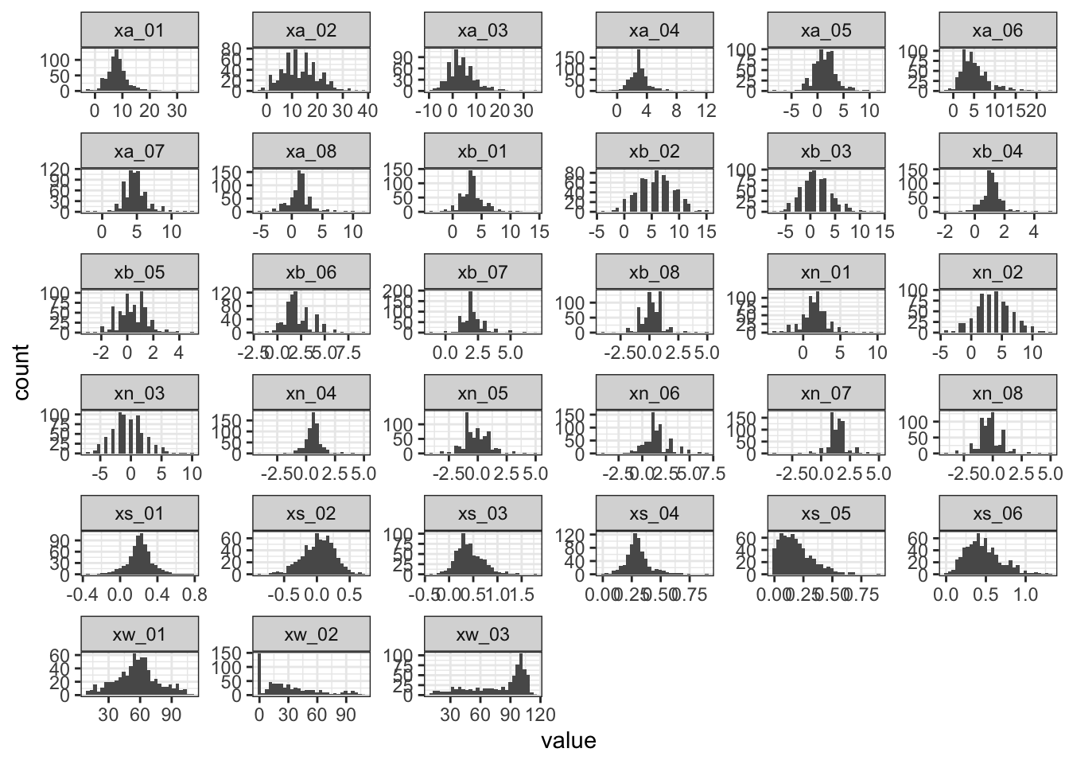
Distributions for continuous variables.
Most of the the distributions are Gaussian like. But some are not, like xw_02,xw_03.

Slide 7
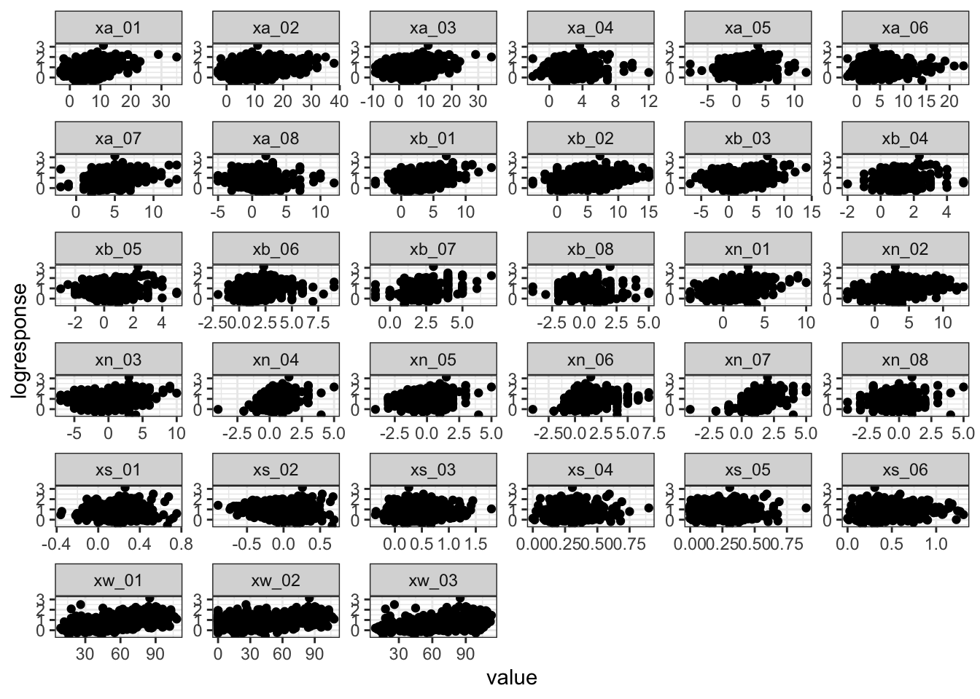
Relationships between the continuous log-transformed response

Slide 8
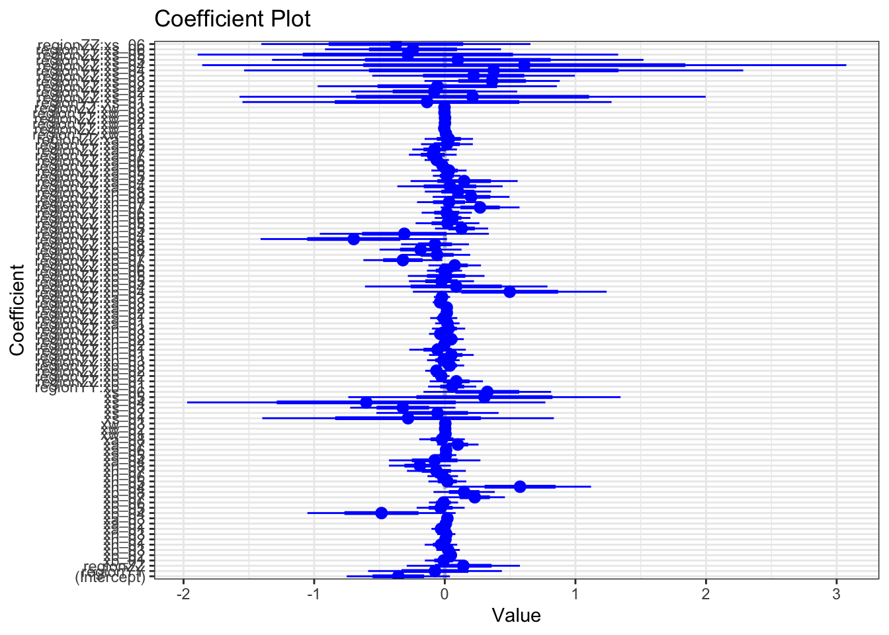
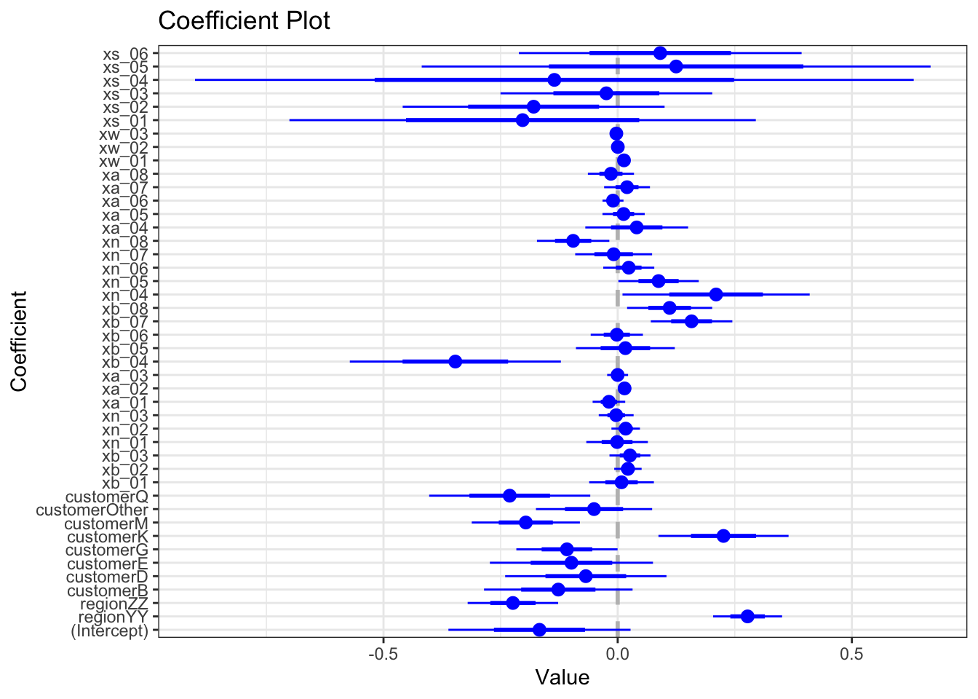
Part II: Regression
Nine models were trained. The top two models are:

Slide 9
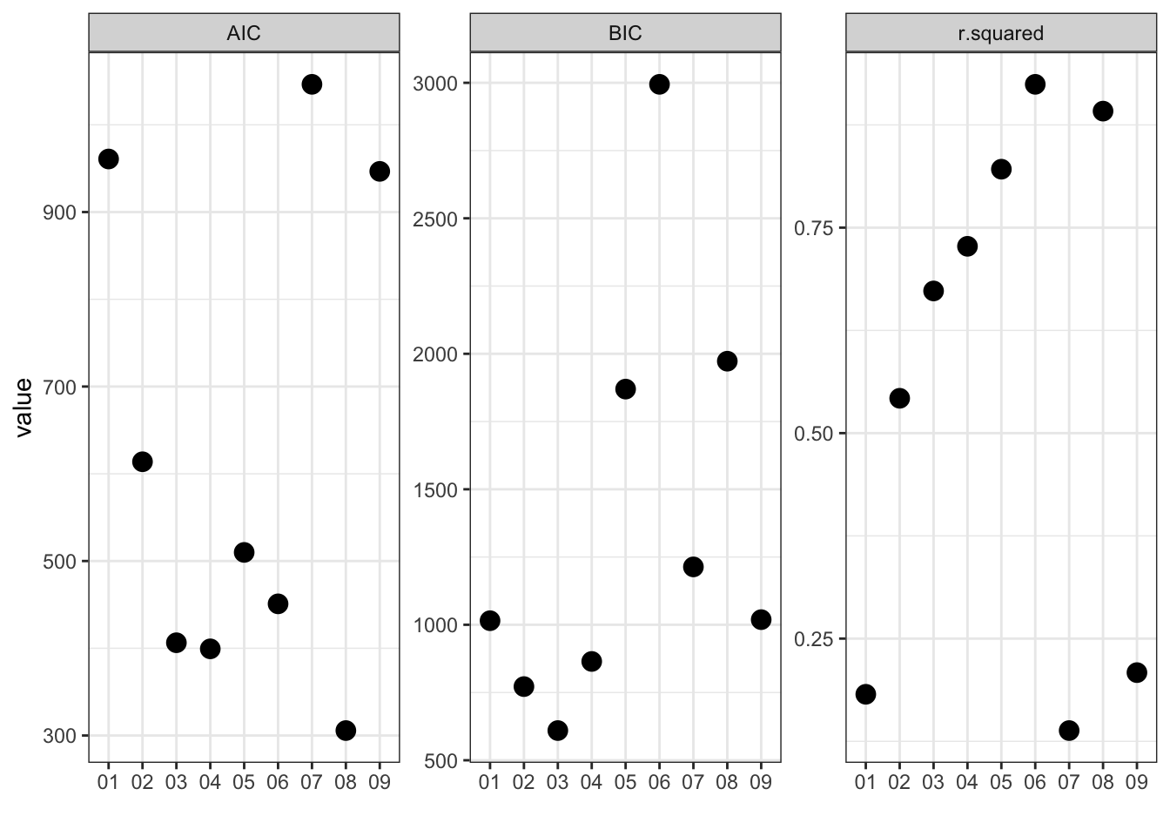
Performance metrics for the determination of the best model.

Slide 10
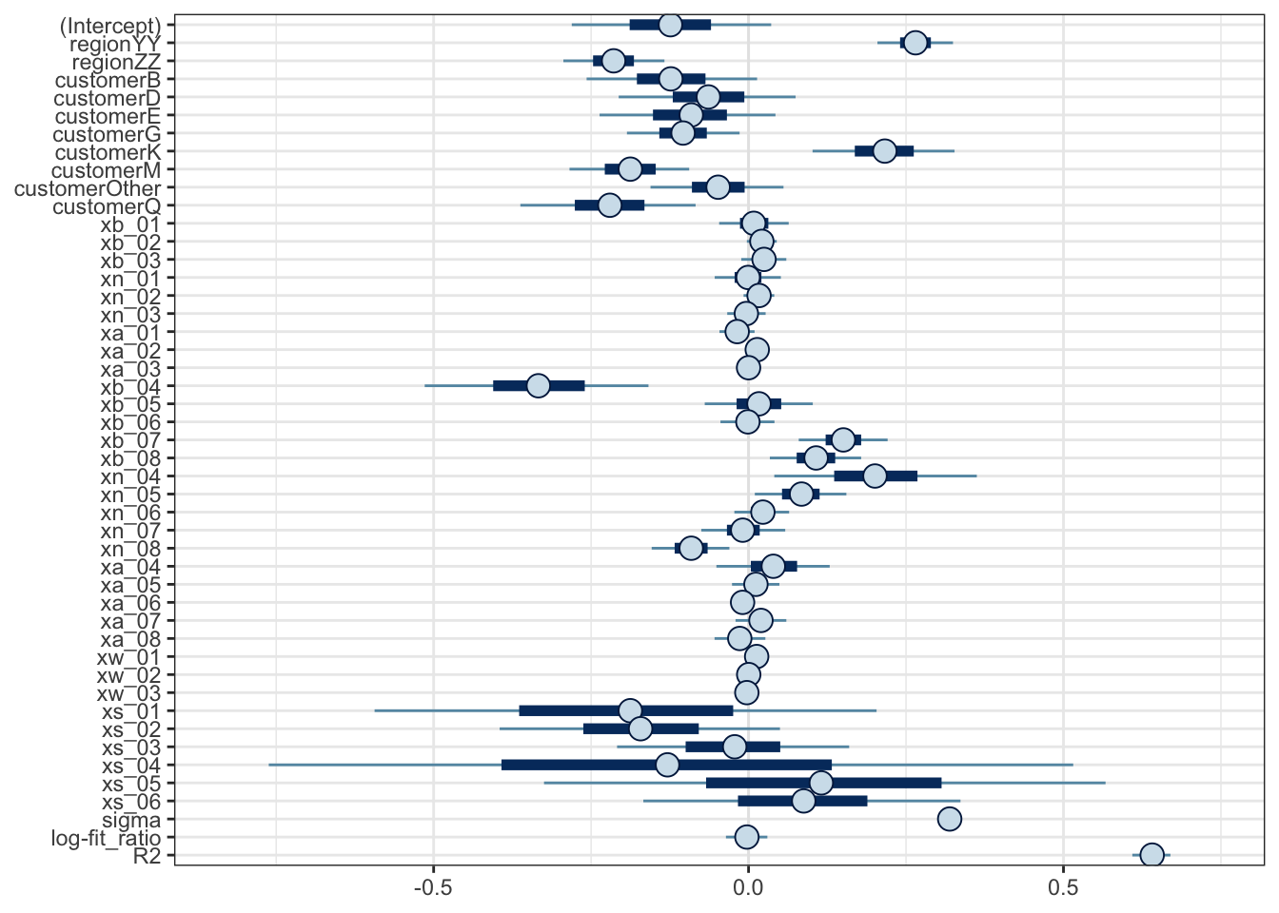
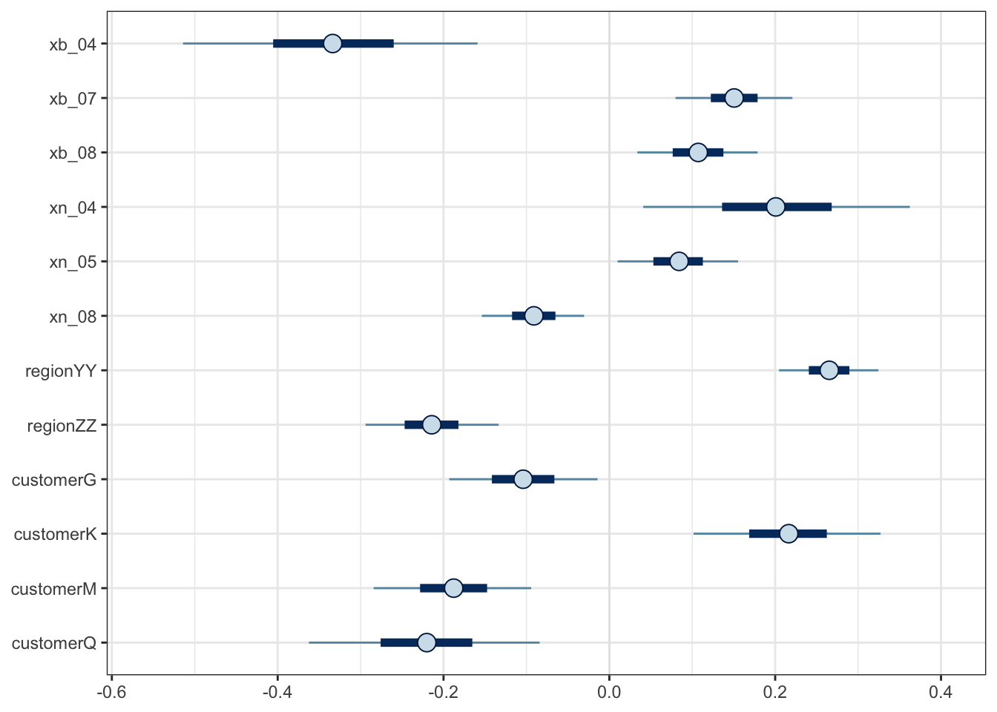
Posterior visualizations

Slide 11
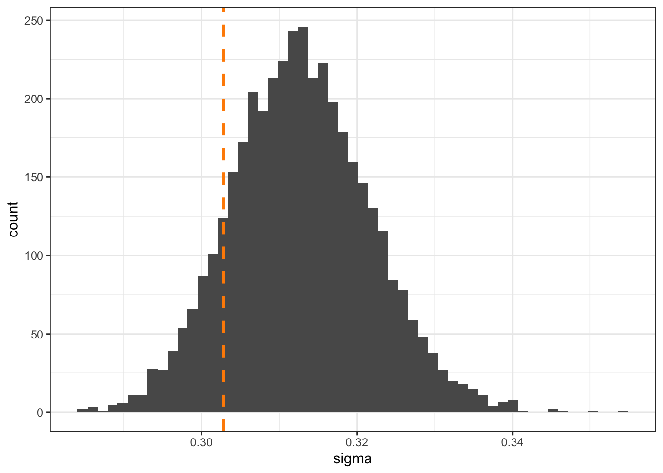
Comparison between maximum likelihood estimation and sigma distribution from Bayesian linear model.

Slide 12
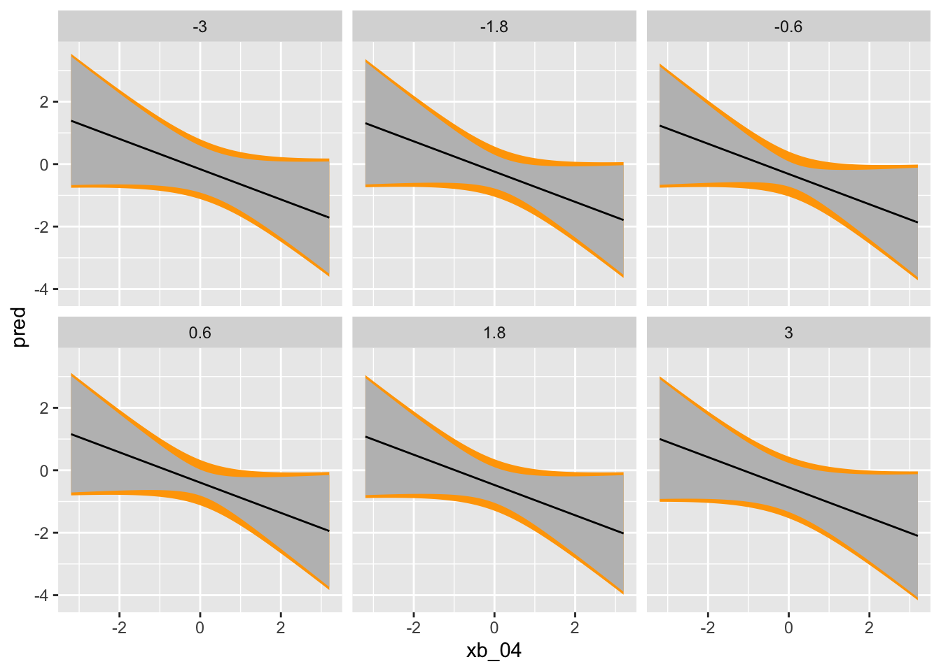
Prediction from the best linear model

Slide 13
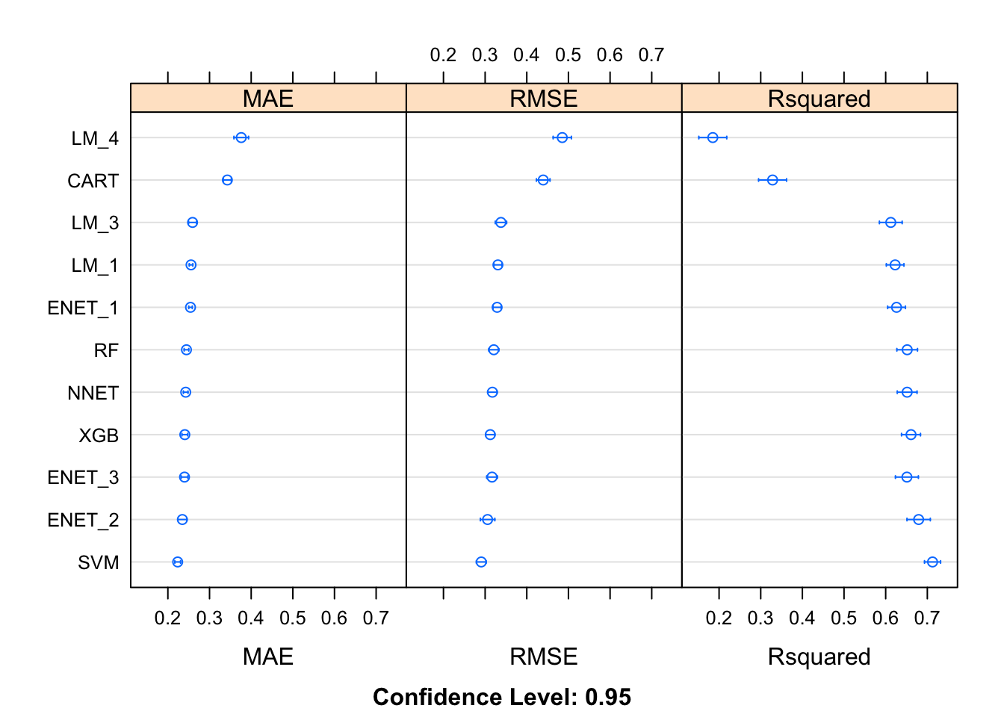
Train the following models:
• Linear models:
• Regularized regression with Elastic net
• Neural network • Random forest • Gradient boosted tree
According to the results of MAE, RMSE and Rsquare, SVM model was considered as the best model.

Slide 14
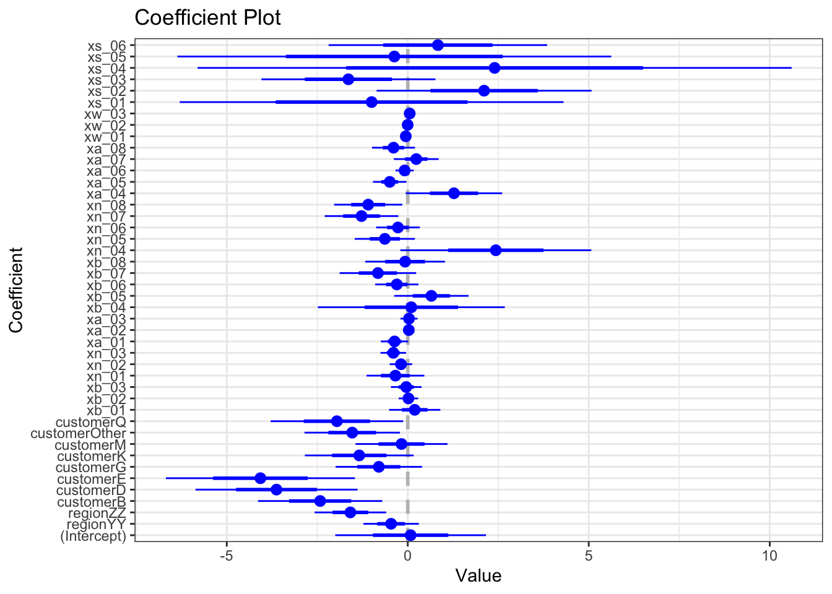
Part III: Classification
Nine models were trained. The coefficients of the best model:

Slide 15
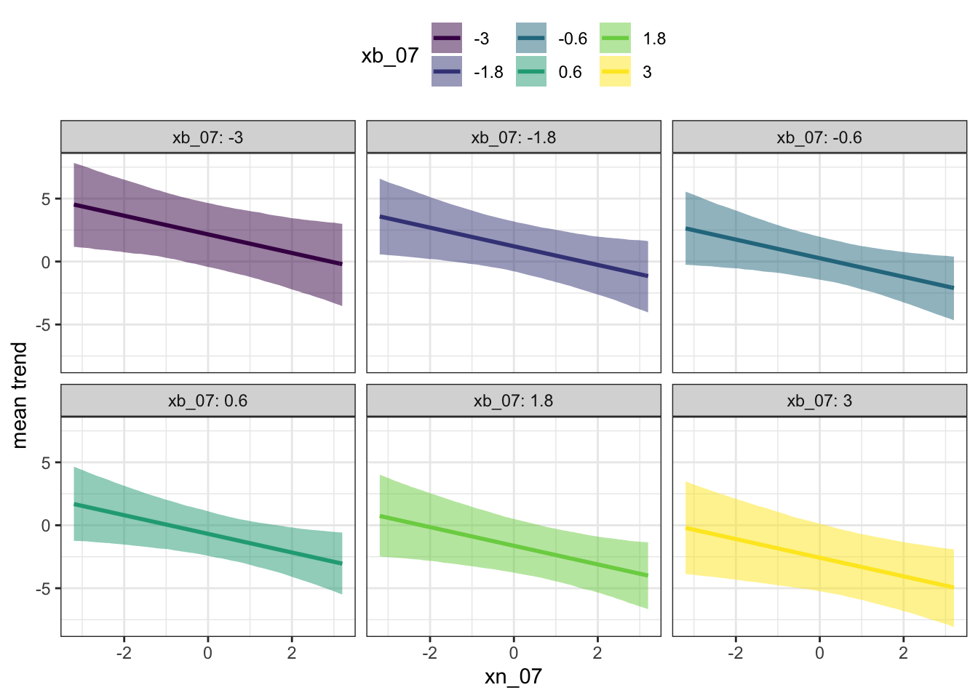
Prediction from the best linear model

Slide 16
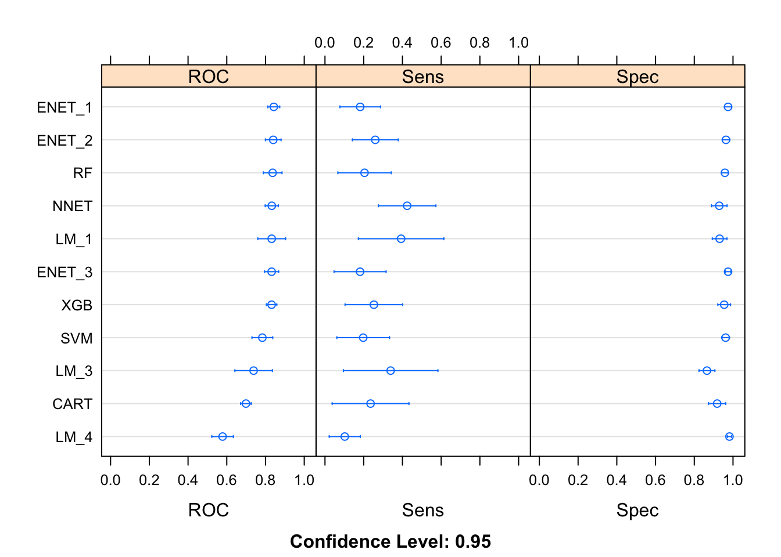
Train the following models:
• Linear models:
• Regularized regression with Elastic net
• Neural network • Random forest • Gradient boosted tree
Specificity, Enet_1, Enet_1, RF, NNET were chosen as the top four best models.

Slide 17
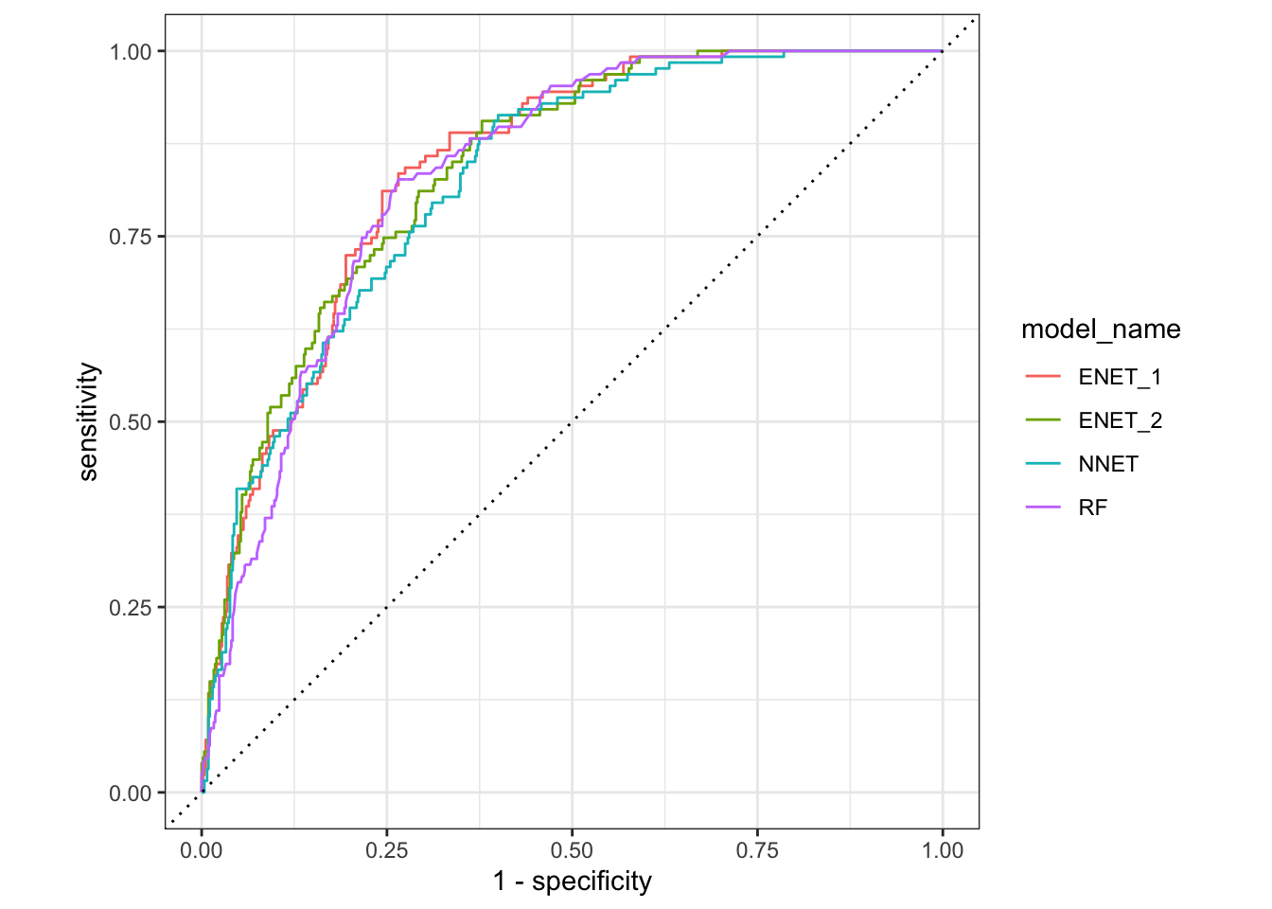
According to the the AUC, the ENET_1 is the best model.

Slide 18
Customer as the hardest to predict in the regression task
for(customer in c("A","B","D","E","G","K","M","other","Q")){ small_table=resample_pred_classification_1[which(resample_pred_classification_1$customer==customer),] rmse_value=RMSE(small_table$obs,small_table$pred) print(rmse_value)}##
[1] 0.2825646##
[1] 0.2361583##
[1] 0.330868##
[1] 0.2960522##
[1] 0.3179564##
[1] 0.4696322##
[1] 0.2816986##
[1] NaN##
[1] 0.3796271
According to the RMSE results, the greater the RMSE value, the harder the customer is to predict. So, we can see that customer K is the hardest customer to predict.

Slide 19
Customer as the hardest to predict in the calssification task
for(customer in c("A","B","D","E","G","K","M","other","Q")){ small_table=resample_pred_classification[which(resample_pred_classification$customer==customer),] roc_value =small_table%>%roc_auc(obs,event)
print(roc_value$.estimate)}##
[1] 0.7836502##
[1] 0.5594968##
[1] 0.7984682##
[1] 0.7923828##
[1] 0.9192084##
[1] 0.6889554##
[1] 0.8970789
According to the classification ROC results, we can see that the smaller the ROC value is, the harder the customer is to predict. Customer B should be the hardest to predict in classification model.

Slide 20
Conclusions:
The following conclusions can be drawn from this project:
The best models were developed for the regression and classification task.
The most important input variables were found from the models for both regression and classification.
Customers were identified as the most difficult to predict in terms of time and achieving sales goals.
It was found that sentiment derived features are helpful at predicting the outputs.

